Slide 1
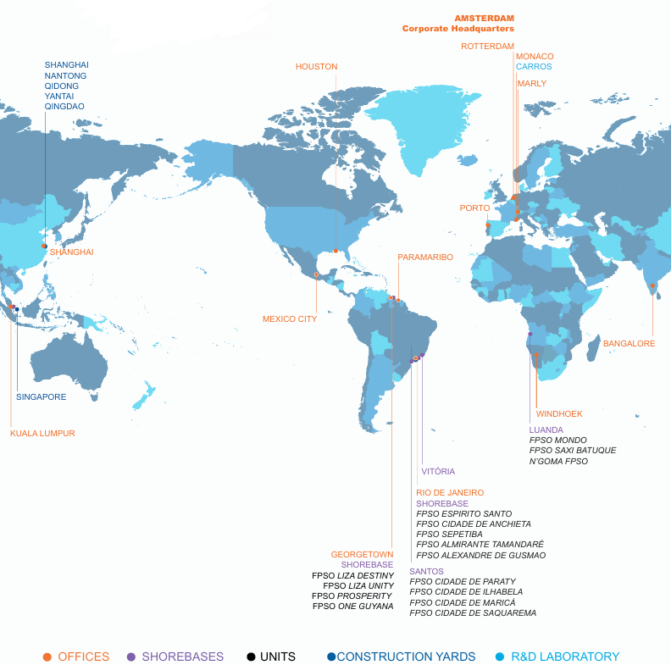
Appendix 1 - Overview of Taxes – SBM Offshore Global Presence

Slide 2
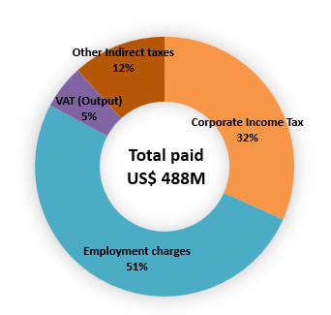

Overview of Taxes – 2025 Current Tax Liabilities (IFRS)
Corporate Tax Footprint of the Group at a Glance (in millions US$): Overall Tax Footprint of the Group (in millions US$):
Guyana
US$ 47.2
Brazil
US$ 21.7
United Kingdom
US$ 16.9
Switzerland
US$ 24.2
India
US$ 1.9
China
US$ 0.6
Mexico
US$ 1.2
Equatorial Guinea
US$ 1.9
Angola
US$ 35.8
Monaco
US$ 1.4
Malaysia
US$ 0.4

Slide 3
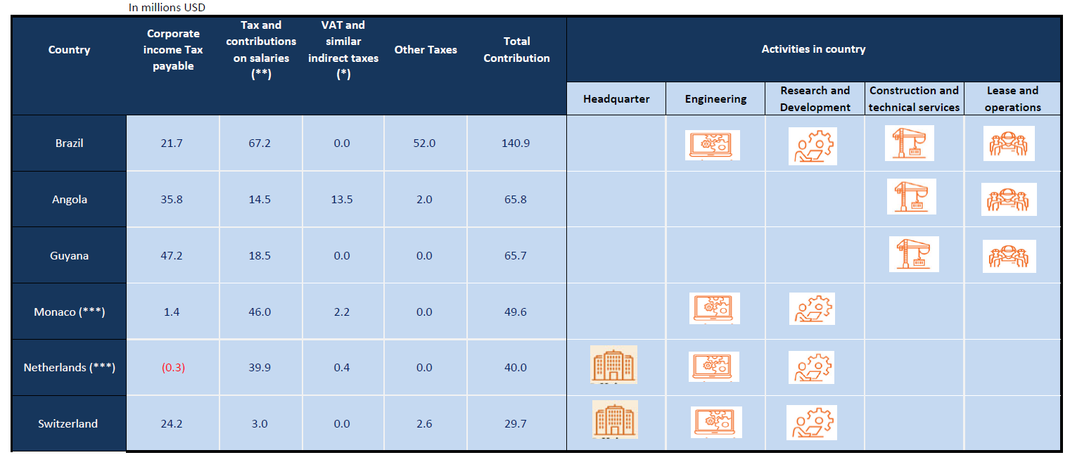
Top 10 Tax Contributions by Jurisdiction in 2025 (in millions US$) – IFRS

Slide 4
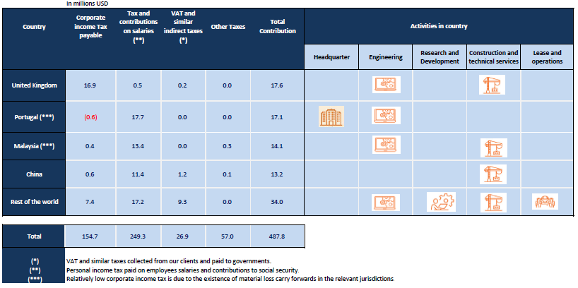
Top 10 Tax Contributions by Jurisdiction in 2025 (in millions US$) – IFRS
Focus
Tax & Contributions on salaries for « Rest of the world » US$ 17.2 includes:
India (7.6 US$); Singapore (US$ 3.2); US (US$ 2); Equatorial Guinea (US$ 2.4);
France (US$ 1.1); Canada (US$ 0.2); Denmark (US$ 0.2);
Mexico (US$ 0.2) ; Namibia (US$ 0.1); Norway (<US$ 0.1); Suriname (<US$ 0.1).

